Slide 1
TITLE: EXAM HALL SEAT ALLOCATION SYSTEM.
GROUP 9

Slide 2
GROUP MEMBERS
ADOBOR, ISAAC OGHENECHUKO 215IT01002706
SAM-ARTHUR, ERIC 215IT01002930
JOSEPH, AGBEMENU 216BE02004096
ABIODUN, OSIGBELU SAMUEL 215IT01002802
STEPHEN, AMOAH-ADJEI 215IT01003240

Slide 3
INTRODUCTION
Examination Hall Seat Allocation System is developed to simplify the allocation of halls with appropriate seat number to students during exams. It facilitates to access the examination information of a particular student in a particular department. The information is sorted information alphabetically, which will be provided by the teacher for a respective department. This system also helps in finding the examination eligibility criteria of a student of the particular department.

Slide 4
OBJECTIVES
To computerize the traditional way of assigning seats in exams.
To generate the seating arrangement automatically.
To relieve both students and exams coordinators from stressful search for names and seat at notice board and pasting of seat allocation all around on the various exams centers.
To prevent exams malpractices, since student’s seats will be generated randomly irrespective of the course or department of the student.

Slide 5
SCOPE
The scope of the project is the designing of a web interface and it will be given to a college for future use.
PROJECT OVER VIEW:
This project is containing the user requirement engineering for exam hall seat allocation system prepared for the client (Mr. Emmanuel Prah, VVU exams officer).

Slide 6
USER REQUIREMENTS SPECIFICATION
The user (exams officers) are able to enter and generate the seat allocation.
The main specification outlines by the user is to be able to make sure that a student is not surrounded by a colleague who is writing the same paper since this will prevent malpractices.
The user also seeks that, if the exams hall contains students writing the same paper, the system should be able to generate double even numbers in other to give spacing between students to prevent malpractice.
The system should also be able to generate set of numbers for a particular department if the exams hall contains different departmental students. Example: to generate seat number 1 to 20 for IT students writing information systems, seat number 21 to 40 for biomedical students writing medical imaging.

Slide 7
STUDY OF THE SYSTEM MODULES: This system has been divided or broken into modules in other to explain the block functionalities of the system. The modules involved are:
Administrator
student

Slide 8
ADMINISTRATOR
The administrator is the main controller or manager of this system. Only admin have access into this admin page with detailed login information. The administrator has all the information about all the user. This module is divided into different sub-modules which he manages.
User/student
Department
course
4. hall
The admin can perform the following activities using the system.

Slide 9
Log onto the system and logout with login username and password.
View and add student information onto the system by entering them one after the other or uploading large number of student’s information in a csv file.
The admin can also add departments that are to be involved in the exams, the courses and hall where the exams would take place.
The admin has the opportunity to delete and edit from any of the submodules whenever he/she wishes to do so.

Slide 10
ADMIN MODULE
MANAGE DEPARTMENT
MANAGE COURSE
ADMIN
MANAGE HALL
MANAGE USER

Slide 11
MANAGE USER
SEARCH USER
EDIT USER
MANAGE USER
ADD USER
DELETE USER

Slide 12
MANAGE HALL
EDIT HALL
DELETE HALL
MANAGE HALL
ADD HALL
ALLOCATE HALL

Slide 13
3 User
Inside the student module is other sub-models which are:
Add course
View course
View seat
Student ID (sub modules: edit profile, change password, logout)
The student has the opportunity to perform the following activities at the student page
The student can login onto and logout the system using username and password.
.

Slide 14
He can add the courses that is going to be written in the exams
Can view the courses added
Can also view seats that will tell the student the hall name and seat number of that particular paper exams
The student has the privilege to view profile.
The student has the privilege to delete and edit from any category of under the student ID submodule are also other submodules that can enable the student to edit profile, change password.

Slide 15
USER MODULE
ADD COURSE
VIEW SEAT
USER
EDIT PROFILE
VIEW COURSE

Slide 16
BEHAVIORAL DIAGRAM

Slide 17
SEQUENCE DIAGRAM

Slide 18
Use case diagram

Slide 19
USER REQUIREMENT SPECIFICATION.
The user (exams officers) are able to enter and generate the seat allocation.
1.The main specification outlines by the user is to be able to make sure that a student is not surrounded by a colleague who is writing the same paper since this will prevent malpractices.
2.The user also seeks that, if the exams hall contains students writing the same paper, the system should be able to generate double even numbers in other to give spacing between students to prevent malpractice.
3.The system should also be able to generate set of numbers for a particular department if the exams hall contains different departmental students. Example: o generate seat number 1 to 20 for it students writing information systems, seat number 21 to 40 for biomedical students writing medical imaging.

Slide 20
FUNCTIONAL REQUIREMENTS
The functional requirements of the system simply old is that the system delivered in order to meet user’s requirement as mentioned in the user specification.
i. Check examination hall
ii. Check seat number
Print exams seat slip before exams.
NON-FUNCTIONAL REQUIREMENT
All other to do task that are not present in the functional requirements will be considered as the non-functional requirement

Slide 21
SOFTWARE ENVIRONMENT
1 HTML/php
HTML is an application Standard Generalized
Markup Language (SGML). It approved in 1986.HTML and
SGML is to define WWW hyper document and inter
connectivity. When we compare HTML, it is quite better
than SGML.

Slide 22
BACK END
MySQL server is powerful database and it requires limited programs and used has back end. It supports GUI and more application is developed by help this server. Collection of tables, which holds the data is called database. A beginner can create their own database by click home page.
TABLES
Collection of similar data is called tables in MySQL. These tables are stored in the same database file because they often have some changes if require. And it can be fill out easily.

Slide 23
CONCLUSION
A web based interface for showing hall name for student is developed, which makes students to see their seat in respective hall, easily. A web based interface for analyzing the student academic details are developed. Username and password is created for unique user by register their details in register module. And they can change it by the permission of administrator only.

Slide 24
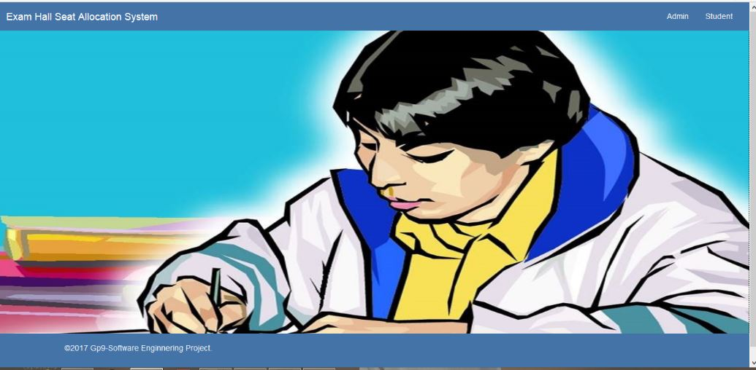
SNAPSHOT

Slide 25
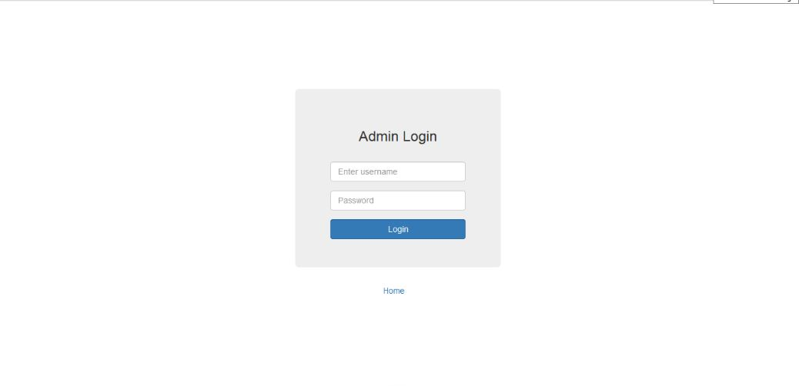

Slide 26
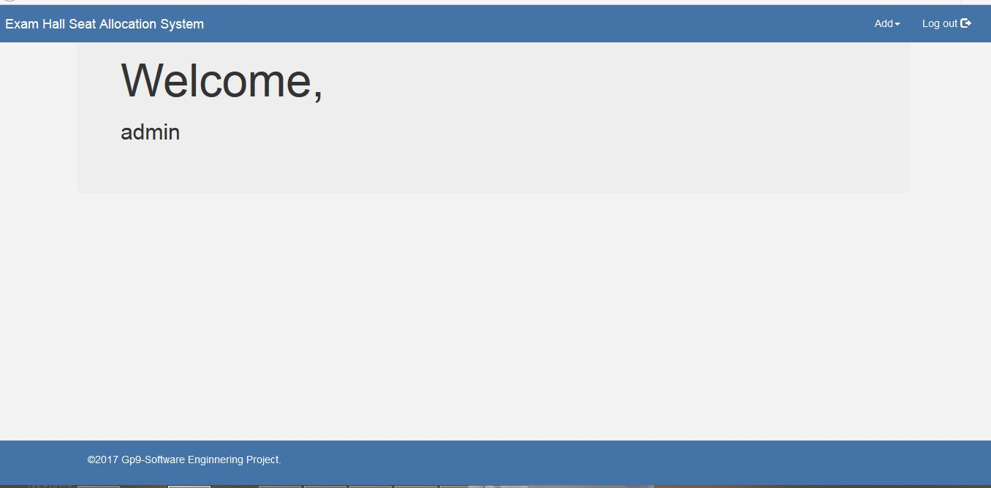

Slide 27
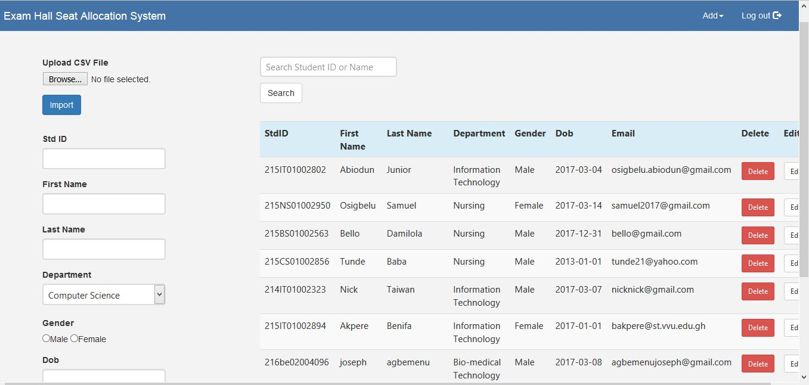

Slide 28
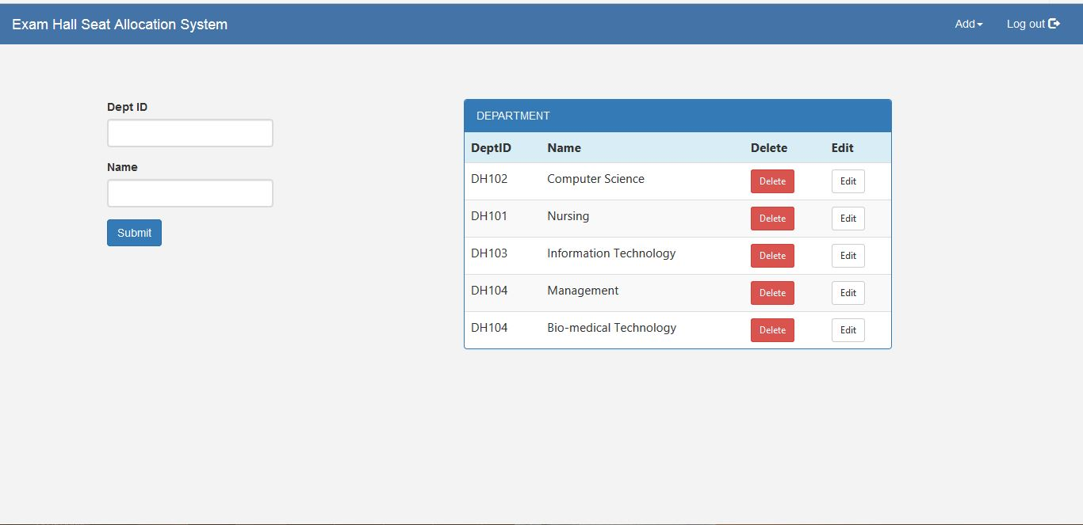

Slide 29
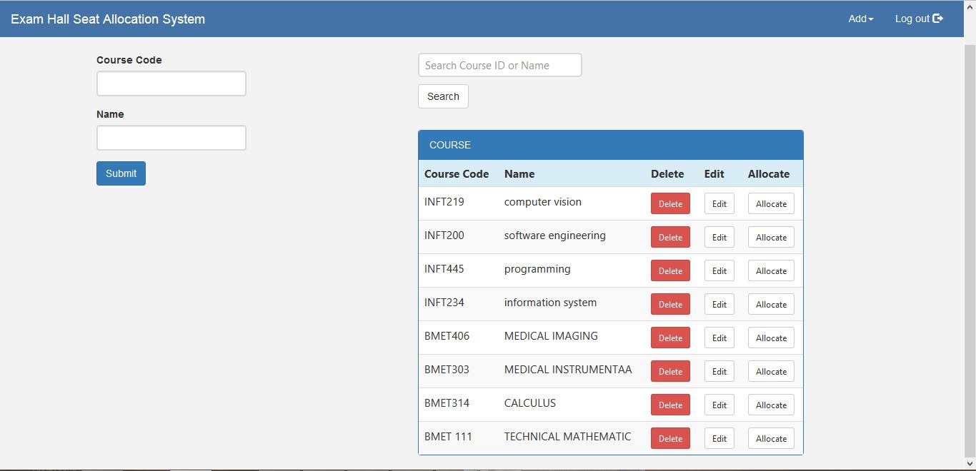

Slide 30
